Slide 1
Animal Vocab
CUDAP Sign Choir
2/21/2018

Slide 2
Word List
Animal
Bear
Bird
Bug
Cat
Cow
Deer
Dog
Elephant
Fox
Frog
Giraffe
Hippopotamus
Horse
Lion
Monkey
Mouse
Octopus
Owl
Pig
Rabbit
Raccoon
Sheep
Skunk
Tiger
Turtle
Wolf

Slide 3
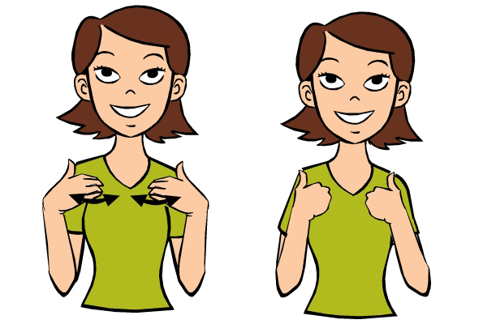
Animal
DESCRIPTION: Touch bent hands to chest and push in and out twice

Slide 4
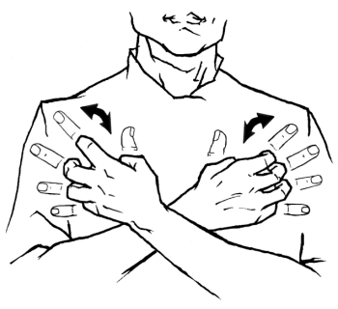
Bear
DESCRIPTION: Cross arms over chest and make clawing motion

Slide 5
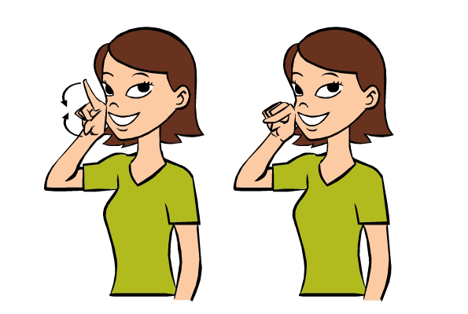
Bird
DESCRIPTION: In front of face, tap right index finger and thumb together, like a beak

Slide 6
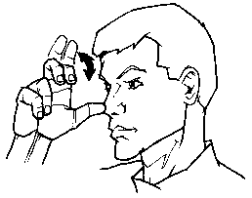
Bug
DESCRIPTION:Touch sideways 3 hand to nose, bend index and middle fingers a few times

Slide 7
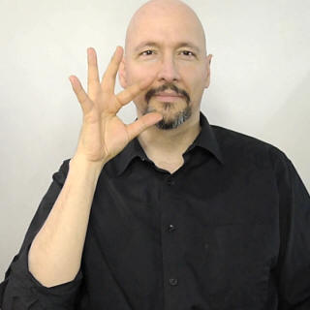
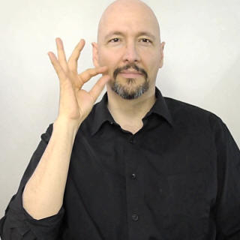
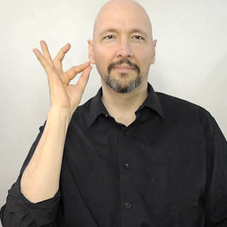
Cat
DESCRIPTION: Pull F-hand from nose outwards, suggesting a cat’s whiskers

Slide 8
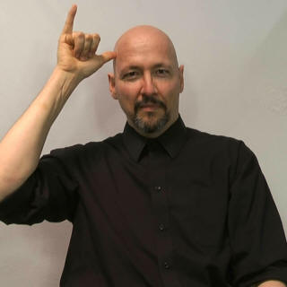
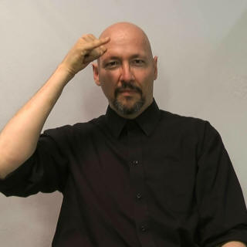
Cow
DESCRIPTION:Make horn with Y-hand, tilt forward twice

Slide 9
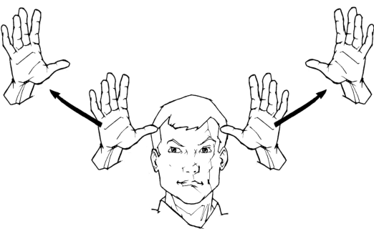
Deer
DESCRIPTION: Make antlers with two 5-hands; move from head outwards

Slide 10
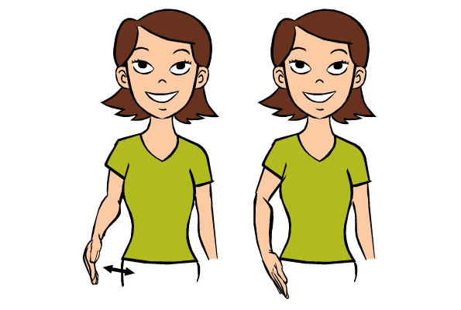
Dog
DESCRIPTION:Pat flat hand against your thigh
NOTE: There are several common signs for “dog;” another common variation is snapping your right hand

Slide 11
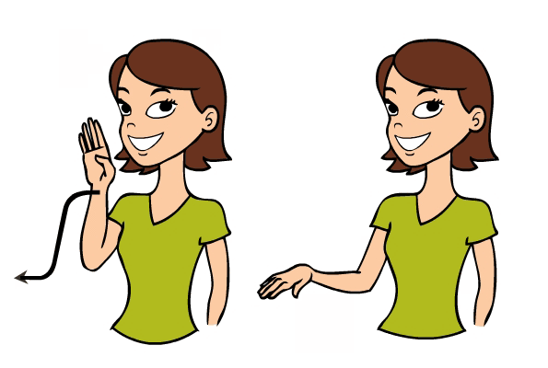
Elephant
DESCRIPTION:Trace the shape of an elephant’s trunk using right flat hand

Slide 12
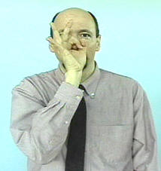
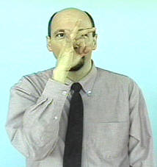
Fox
DESCRIPTION:Twist right F-hand in front of nose

Slide 13
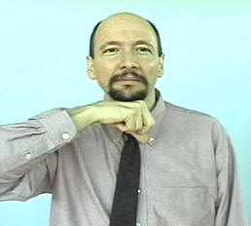
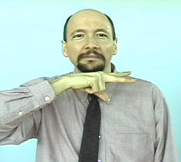
Frog
DESCRIPTION:Hold right fist under chin, flick out index and middle fingers twice

Slide 14
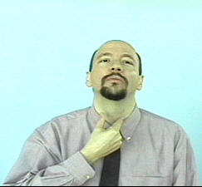
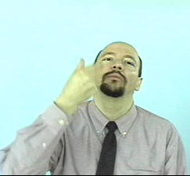
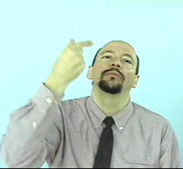
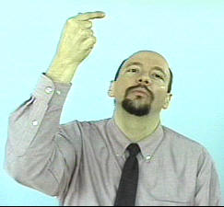
Giraffe
DESCRIPTION:Use right G-hand to trace a long neck

Slide 15
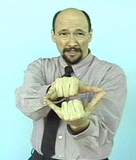
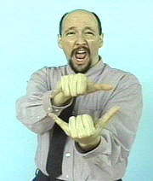
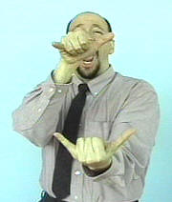
Hippopotamus
DESCRIPTION: Use two Y-hands to suggest a hippo’s jaw biting down twice

Slide 16
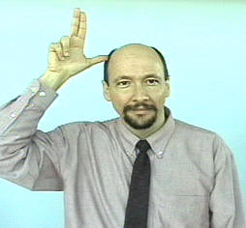
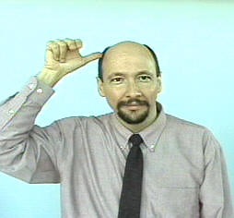
Horse
DESCRIPTION:Touch thumb to head with index and middle fingers sticking up. Bend index and middle fingers twice

Slide 17
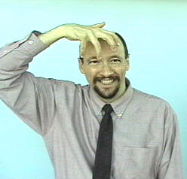
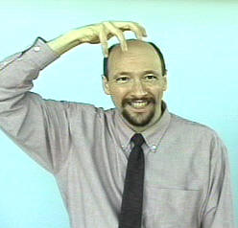
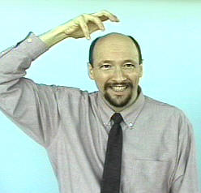
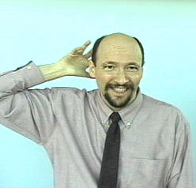
Lion
DESCRIPTION: Move a clawed 5-hand over the top of your head

Slide 18
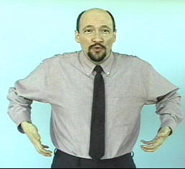
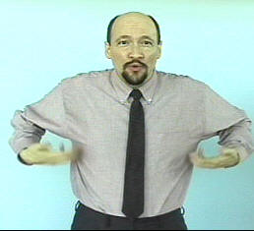
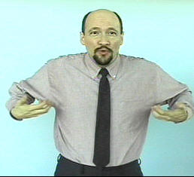
Monkey
DESCRIPTION:Claw up your torso towards your armpits twice

Slide 19
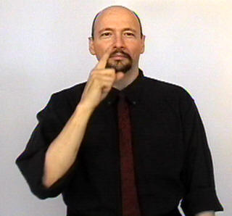
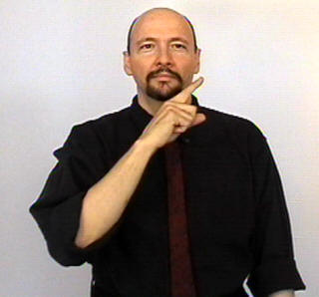
Mouse
DESCRIPTION: Brush index finger against nose twice

Slide 20
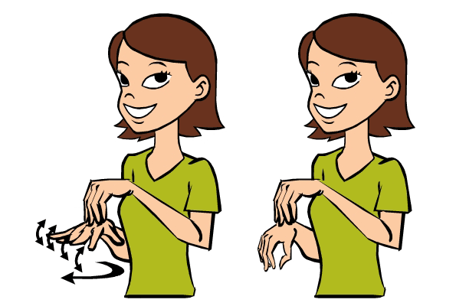
Octopus
DESCRIPTION: Make the octopus’ head with right flattened O-hand; with left hand, wiggle fingers and move forward
NOTE: Picture show a left-handed signer, so hands are reversed

Slide 21
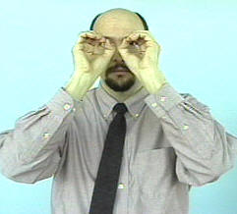
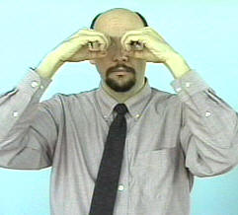
Owl
DESCRIPTION:Twist O-hands in front of eyes

Slide 22
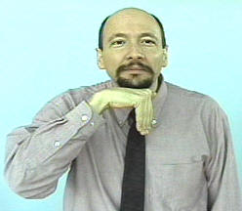
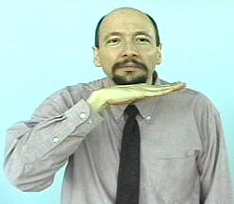
Pig
DESCRIPTION:Under chin, bend and flatten hand twice

Slide 23
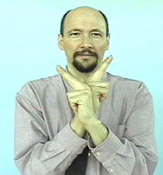
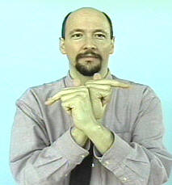
Rabbit
DESCRIPTION: Cross arms over chest with index and middle fingers up; bend index and middle fingers twice
MEMORY AID: The white rabbit in Alice in Wonderland wears a bow tie

Slide 24
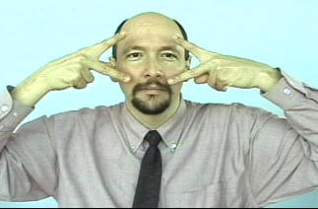
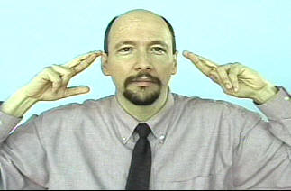
Raccoon
DESCRIPTION: Hold V-hands in front of eyes, pull to side into R-hands

Slide 25
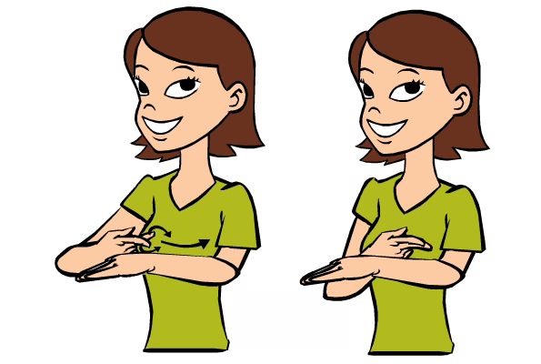
Sheep
DESCRIPTION: Start with right V-hand at left wrist; move right hand up left arm, touching index and middle fingers together a few times, as if shearing a sheep

Slide 26
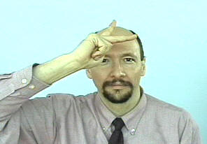
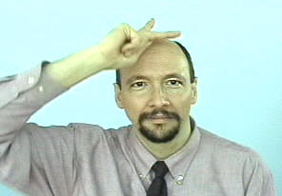
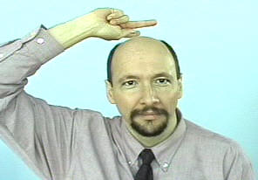
Skunk
DESCRIPTION: Move K-hand over top of head, to suggest a skunk’s white stripe

Slide 27
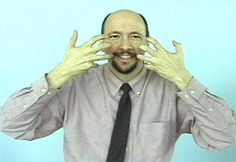
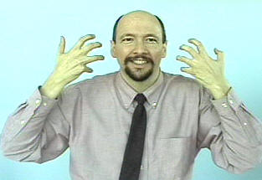
Tiger
DESCRIPTION: Hold clawed 5-hands in front of face, move outward to suggest tiger stripes

Slide 28
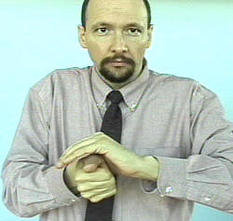


Turtle
DESCRIPTION: Cover sideways A-hand with left hand; move thumb side-to-side a few times to suggest a turtle’s head poking around

Slide 29



Wolf
DESCRIPTION: Start with slightly clawed 5-hand in front of face, pull out to bent hand, suggesting a wolf’s snout

Slide 30
Questions?

